Slide 1

Honors Project Lexical Analyzer in c
By: Bemnet Merkebu

Slide 2
Overview
Lexical Analyzer: Process a source code into meaningful tokens (lexemes)
Input Buffer
Tokenize
Next token

Slide 3
Overview
Input Buffer
Helper Functions
Main Lexer Function

Slide 4
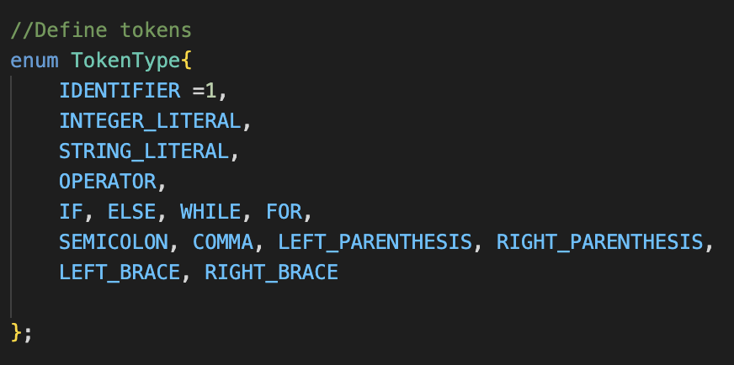
Steps taken
Define the essential token type that are needed
Implement with enumerated list, (indexed list)

Slide 5
Steps taken
Important tokens in C (main language components)
Identifiers in C ( _int, INT, int, inT, in_T)
Keywords in C (If, Else, While, For, print)
Operators in C (+, -, /, *)
Strings in C
Special Characters in C ( ; . , \ )
Constant in C ( 1 , 2 , 4, .. isDigit())

Slide 6
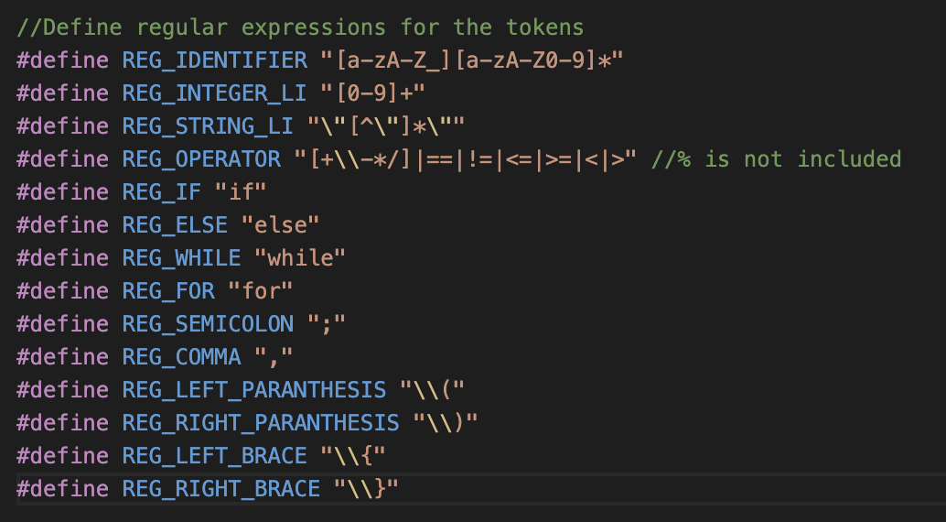
Steps taken
Define regular expressions for the tokens defined above
Offer more capabilities to match and capture characters

Slide 7
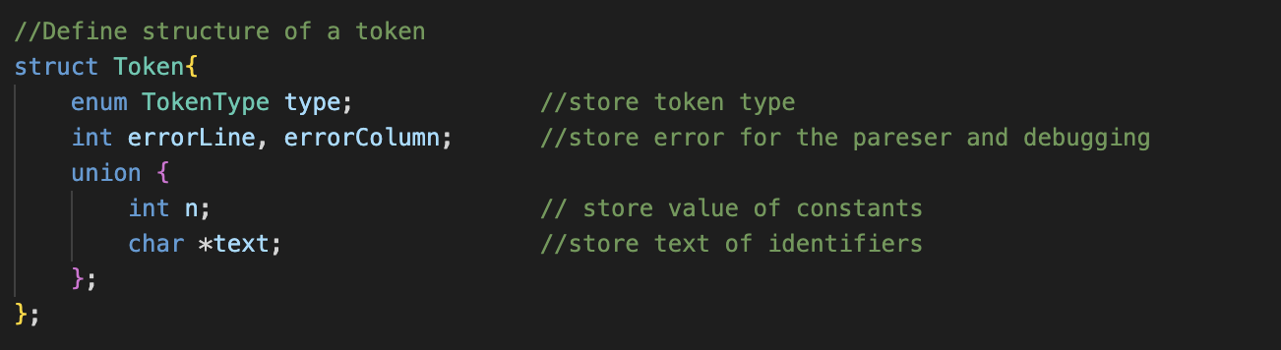
Token structure
Define struct to handle the data of tokens
Value
Int – for numerical values
Char – for other values
Token Type
Error storage (For the next part of the compiler)

Slide 8
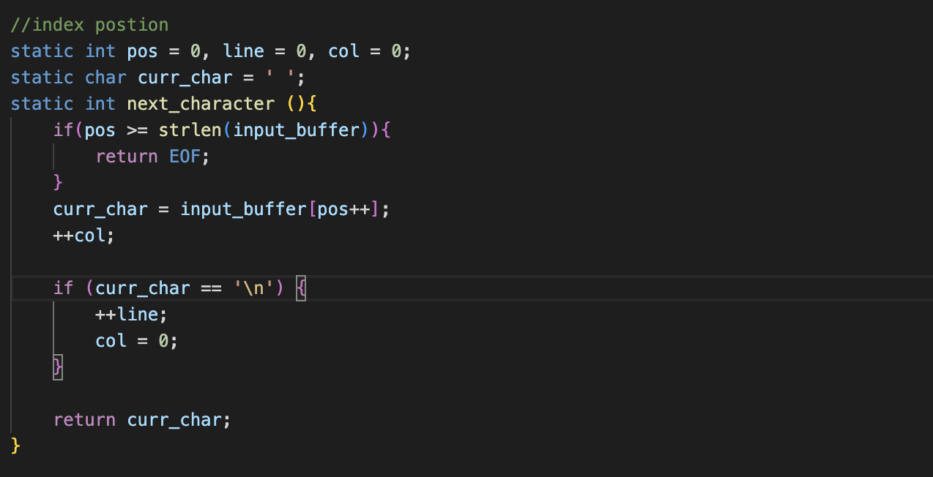
Helper function (1) – Next character
Iterate through a string (stream of characters)
Return the next character to analyze
Base case, Curr_char is NULL

Slide 9
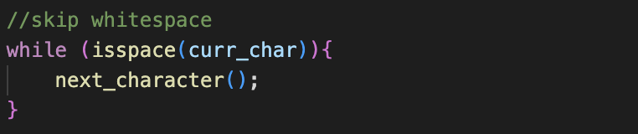
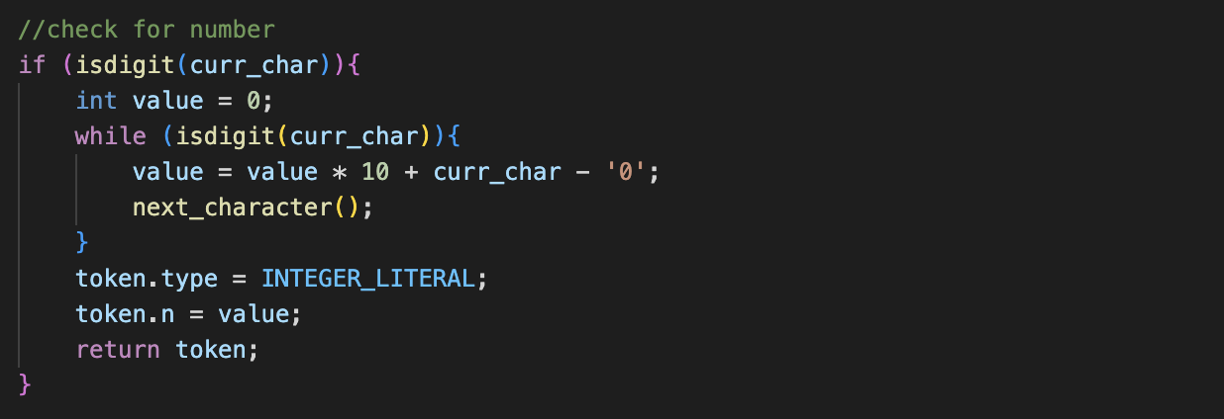
Helper functions (2) – <ctype.h>
Match digits for instance
From Generic C library
Checks if a current character is digit or not

Slide 10
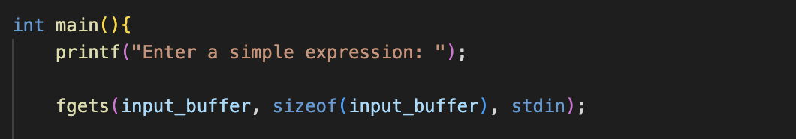
Input buffer
Input buffer
Save the raw code in a file
As of now, I am testing it by direct input
Goal: to open a file with code -> print analysis

Slide 11
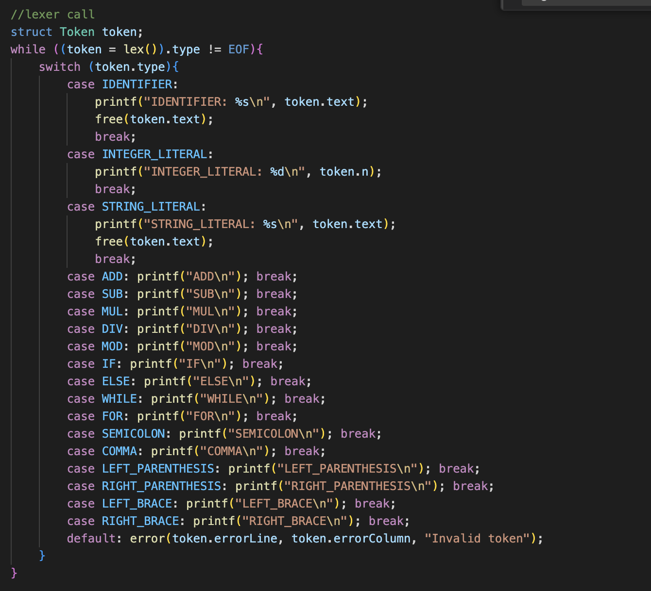
Tiny state machine
Process through the stream of characters as special characters as a delimiter

Slide 12
Tiny state machine
State machine diagram

